Slide 1
Lecture 2: 4CS015
Digital Electronics
1

Slide 2
A.Coverage
Boolean Logic and Logic Gates
Truth Table
Boolean Algebra Laws
Combinational Circuit
A.Coverage
1. Boolean Logic
1.1 Basic Definitions
2

Slide 3
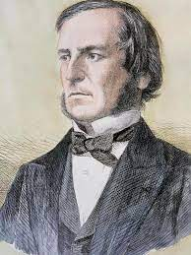
1. Boolean Logic History
George Boole (1815-1864)
“An Investigation into the Laws of Thought”
Defined an algebra for solving logical problems
Limited to dealing with facts True or False
Now known as Boolean Algebra
1. Boolean Logic History
1.1 Basic Definitions
3

Slide 4
1.1 Basic Logic Definitions
In a Logic System a variable can have one of two possible states.
Single capital letters are used to represent variables.
The bits 1 and 0 are also used as constants.
1. Boolean Logic
1.1 Basic Definitions
1.2 Logic States
TRUE | ON | CLOSED | ‘1’ | Yes | 5v
FALSE | OFF | OPEN | ‘0’ | No | 1v
4

Slide 5
1.2 Logic States
If a switch is closed:
The light will be ON.
This can represent Logic TRUE.
If a switch is open:
The light will be OFF.
This can represent Logic FALSE.
The switch is a Logic variable.
1. Boolean Logic
1.1 Basic Definitions
1.2 Logic States
2. Boolean Operators
5

Slide 6
2. Boolean Operators
Boole defined three basic operations that could be used with these Boolean variables.
AND
OR
NOT
All logical expressions can be built from these three.
2. Boolean Operators
6

Slide 7
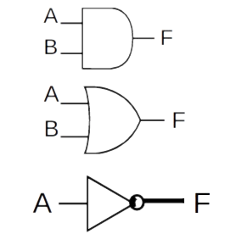
2. Boolean Operators
Logical AND
2. Boolean Operators
2.1 Logical AND
2.2 Logical OR
2.3 Logical NOT
Logical OR
Logical NOT
7

Slide 8
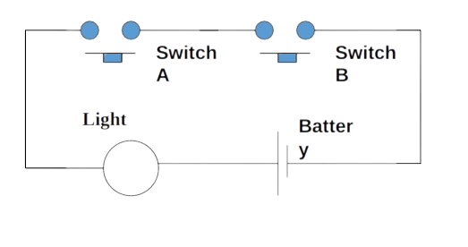
2.1 Logical AND
How can we switch the light on?
2. Boolean Operators
2.1 Logical AND
2.2 Logical OR
2.3 Logical NOT
8

Slide 9
2.1 Logical AND
Boolean Expression:
F = A AND B or F= A∙B
Gate Diagram:
2. Boolean Operators
2.1 Logical AND
2.1.1 AND Relationship 2.2 Logical OR
2.3 Logical NOT
A B
F
Truth Table:
Input A | Input B | Output F
0 | 0 | 0
0 | 1 | 0
1 | 0 | 0
1 | 1 | 1
9

Slide 10
2.1.1 AND Relationship
Boolean representation . (Period)
If F,A and B are Boolean variables.
Then the expression F = A∙B means
F is only true when A AND B are both true.
As A is capable of being 1 or 0 and B is capable of being 1 or 0 there are 4 possible states. 00, 01, 10 or 11
2. Boolean Operators
2.1 Logical AND
2.1.1 AND Relationship 2.2 Logical OR
2.3 Logical NOT
Input A | Input B | Output F
0 | 0 | 0
0 | 1 | 0
1 | 0 | 0
1 | 1 | 1
10

Slide 11

2.2 Logical OR
How can we switch on the light?
2. Boolean Operators
2.1 Logical AND
2.2 Logical OR
2.3 Logical NOT
Switch A
Switch B
Light
Battery
11

Slide 12
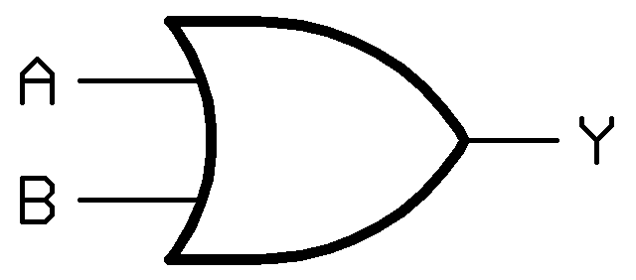
2.2 Logical OR
Boolean Expression:
F = A OR B alternatively F =A+B
Gate Diagram:
2. Boolean Operators
2.1 Logical AND
2.2 Logical OR
2.2.1 OR Relationship
2.3 Logical NOT
Truth Table:
Input A | Input B | Output F
0 | 0 | 0
0 | 1 | 1
1 | 0 | 1
1 | 1 | 1
12

Slide 13
2.2.1 OR Relationship
Boolean representation + (Plus)
If F,A and B are Boolean variables.
Then the expression F = A+B means
F is only true when A OR B, OR both, are true.
As A is capable of being 1 or 0 and B is capable of being 1 or 0 there are 4 possible states. 00, 01, 10 or 11
2. Boolean Operators
2.1 Logical AND
2.2 Logical OR
2.2.1 OR Relationship
2.3 Logical NOT
Input A | Input B | Output F
0 | 0 | 0
0 | 1 | 1
1 | 0 | 1
1 | 1 | 1
13

Slide 14

2.3 Logical Not
Switch A
Light
How can we switch the light off?
Boolean Expression:
F = NOT A or F=!A or F=A’
Battery
2. Boolean Operators
2.1 Logical AND
2.2 Logical OR
2.3 Logical NOT
2.3.1 NOT Relationship
Gate Diagram:
Truth Table:
A
F
Input A | Output F
0 | 1
1 | 0
14

Slide 15
2.3.1 NOT Relationship
The NOT relationship reverses the value.
NOT True is False etc…
The Symbol ( ) used is usually a bar above the variable or expression to be reversed
E.g if A= true then A’ = false
In some circumstances we use !
E.g. if B = true !B = false (easier to type)
2. Boolean Operators
2.1 Logical AND
2.2 Logical OR
2.3 Logical NOT
2.3.1 NOT Relationship
3. Integrated Circuit and Logic gates
15

Slide 16
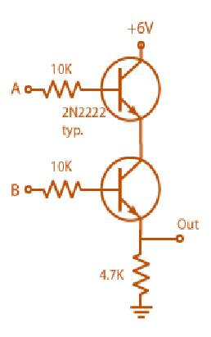
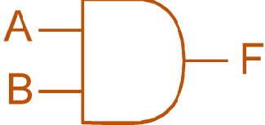


3. Integrated Circuit and Logic Gates
3. Integrated Circuit and Logic gates
16

Slide 17
4. Other Logic Gates
To make life a little easier the basic logical functions are expanded to include:
NAND
This is an AND with a NOT output.
NOR
This is an OR with a NOT output.
XOR
This is the Exclusive OR function.
XNOR
This is Complement of XOR.
4. Other Logic Gates
4.1 NAND
4.2 NOR
4.3 XOR
4.4 XNOR

Slide 18
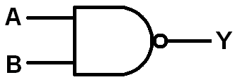
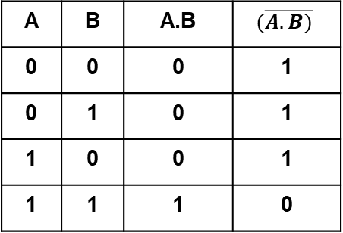
4.1 NAND
Boolean Expression:
F = NOT(A AND B) F = A∙B
Gate Diagram:
4. Other Logic Gates
4.1 NAND
4.2 NOR
4.3 XOR
4.4 XNOR
Truth Table:
A | B | A.B | $$(\overline{A.B)}$$
0 | 0 | 0 | 1
0 | 1 | 0 | 1
1 | 0 | 0 | 1
1 | 1 | 1 | 0

Slide 19
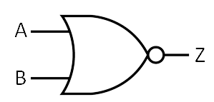
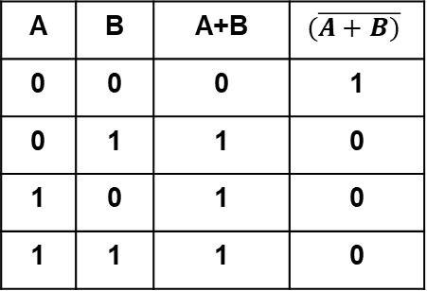
4.2 NOR
Boolean Expression:
F = NOT(A OR B) , F = A+B
Gate Diagram:
4. Other Logic Gates
4.1 NAND
4.2 NOR
4.3 XOR
4.4 XNOR
Truth Table:
A | B | A+B | $$(\overline{A+B)}$$
0 | 0 | 0 | 1
0 | 1 | 1 | 0
1 | 0 | 1 | 0
1 | 1 | 1 | 0

Slide 20
4.3 XOR
generates low output when both the inputs are either low 0or high 1.
Boolean Expression:
F = A XOR B or F = A⊕B
Gate Diagram:
4. Other Logic Gates
4.1 NAND
4.2 NOR
4.3 XOR
4.4 XNOR
A B
F
Truth Table:
Input A | Input B | Output F
0 | 0 | 0
0 | 1 | 1
1 | 0 | 1
1 | 1 | 0

Slide 21
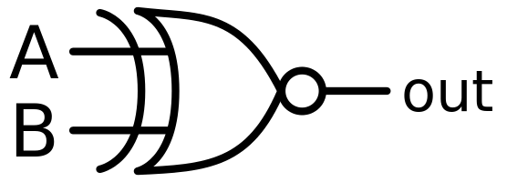
4.4 XNOR
generates high output when both the inputs are either low 0 or high 1.
Boolean Expression:
F = A XNOR B or F = A ☉ B
Gate Diagram:
4. Other Logic Gates
4.1 NAND
4.2 NOR
4.3 XOR
4.4 XNOR
5. Boolean Algebra laws
Truth Table:
Input A | Input B | Output F
0 | 0 | 1
0 | 1 | 0
1 | 0 | 0
1 | 1 | 1

Slide 22
5. Boolean Algebra Laws
The operations +, . And ’ consequently satisfy the basic laws 1, 2 and 3 of Boolean algebra. That is:
A + B ≡ B + A
A ⋅ B ≡ B ⋅ A
Commutative Laws
4. Other Logic Gates
4.1 NAND
4.2 NOR
4.3 XOR
4.4 XNOR
5. Boolean Algebra laws
(A + B) + C ≡ A + (B + C)
(A ⋅ B) ⋅ C ≡ A ⋅ (B ⋅ C)
Associative Laws
A ⋅ (B + C) ≡ (A ⋅ B) + (A ⋅ C)
A + (B ⋅ C) ≡ (A + B) ⋅ (A + C)
Distributive Laws

Slide 23
5. Boolean Algebra Laws
Identity Law Negation Law
A + 0 = A low = high
A . 1 = A ( 0 = 1 )
Idempotent Law
A + A = A
A . A = A
Complement Law
A . A’ = 0
A + A’ = 1
5. Boolean Algebra laws
Double Negation Law
A = A
Domination Law
A + high = high A . low = low
(A + 1 = 1) A . 0 =0
Absorption Law
A + (A .B) = A
A . (A + B) = A

Slide 24
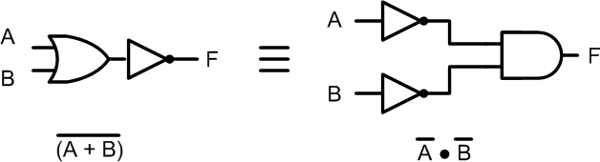
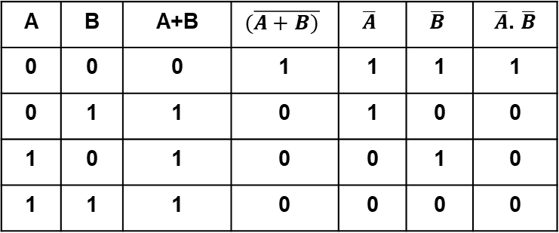
5.1 DeMorgan’s Laws
De Morgan’s 1st Law: “The complement of a sum is equal to the product of the complements”
A+B = A .B
5. Boolean Algebra laws
5.1 DeMorgan’s Laws
6. Universal Gate
A | B | A+B | $$(\overline{A+B)}$$ | $$\overline{A}$$ | $$\overline{B}$$ | $\overline{A}$. $\overline{B}$
0 | 0 | 0 | 1 | 1 | 1 | 1
0 | 1 | 1 | 0 | 1 | 0 | 0
1 | 0 | 1 | 0 | 0 | 1 | 0
1 | 1 | 1 | 0 | 0 | 0 | 0

Slide 25
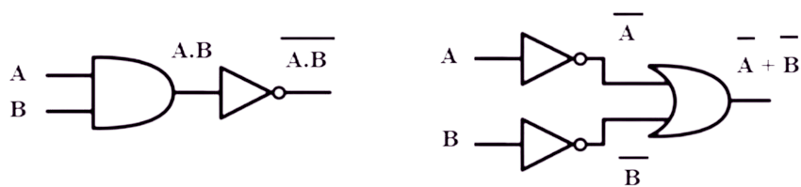
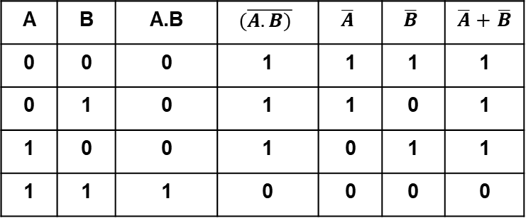
5.1 DeMorgan’s Laws
De Morgan’s 2nd Law: “The complement of a product is equal to the sum of the complements”
A.B = A+.B
5. Boolean Algebra laws
5.1 DeMorgan’s Laws
6. Universal Gate
A | B | A.B | $$(\overline{A.B)}$$ | $$\overline{A}$$ | $$\overline{B}$$ | $\overline{A}+$ $\overline{B}$
0 | 0 | 0 | 1 | 1 | 1 | 1
0 | 1 | 0 | 1 | 1 | 0 | 1
1 | 0 | 0 | 1 | 0 | 1 | 1
1 | 1 | 1 | 0 | 0 | 0 | 0

Slide 26
Universal Gate
The repeated use of a NOR or a NAND gate alone can produce all the three basic logic gates.
5. Boolean Algebra laws
5.1 DeMorgan’s Laws
6. Universal Gate

Slide 27
Question 1 : NAND and NOR gates are called universal gates, why?
6. Universal Gate
6.1 AOI Using NAND gate
6.2 AOI Using NOR gate

Slide 28
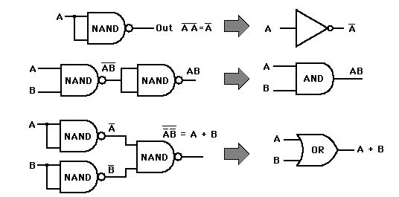
AOI using NAND and NOR gate
Circuit Using NAND gate
Symbol
Logic Function Only
NOT
6. Universal Gate
6.1 AOI Using NAND gate
6.2 AOI Using NOR gate
7. Precedence of operators
AND
OR
AOI using NOR gate?

Slide 29
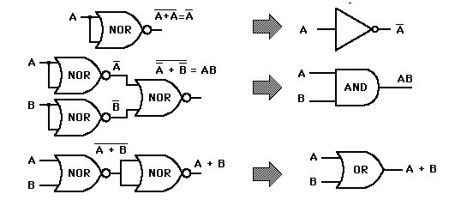
AOI using NAND and NOR gate
Circuit Using NOR gate
Symbol
Logic Function Only
NOT
6. Universal Gate
6.1 AOI Using NAND gate
6.2 AOI Using NOR gate
7. Precedence of operators
AND
OR

Slide 30
7. Precedence of operators
As with normal mathematics when working out the value of a function it is very important to do it in the right order.
NOT AND OR
Parenthesis (brackets) override in the normal way.
When a bar goes above more than 1 symbol it becomes a bracket that reverses.
6. Universal Gate
6.1 AOI Using NAND gate
6.2 AOI Using NOR gate
7. Precedence of operators

Slide 31
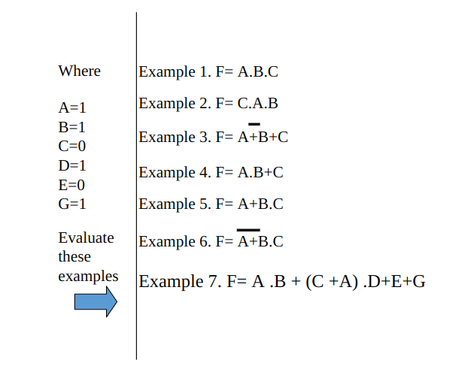
7.1 Example
7. Precedence of operators
7.1 Example
8. Circuit Design

Slide 32
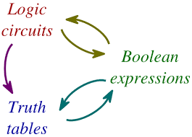
8. Circuit Design
7. Precedence of operators
7.1 Example
8. Circuit Design

Slide 33

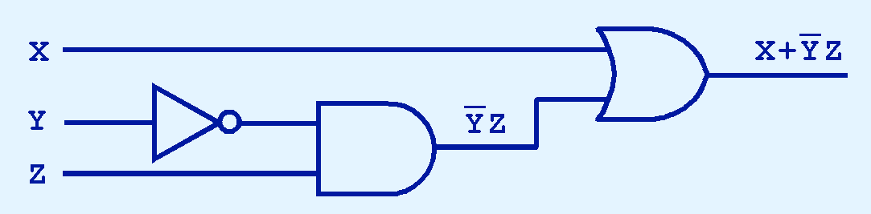
8.1 Digital Component
The main thing to remember is that combinations of gates implement Boolean functions.
The circuit below implements the Boolean function:
8. Circuit Design
8.1 Digital component
8.2 Truth table
8.3 Combinational Logic
We simplify our Boolean expressions so that we can create simpler circuits.

Slide 34
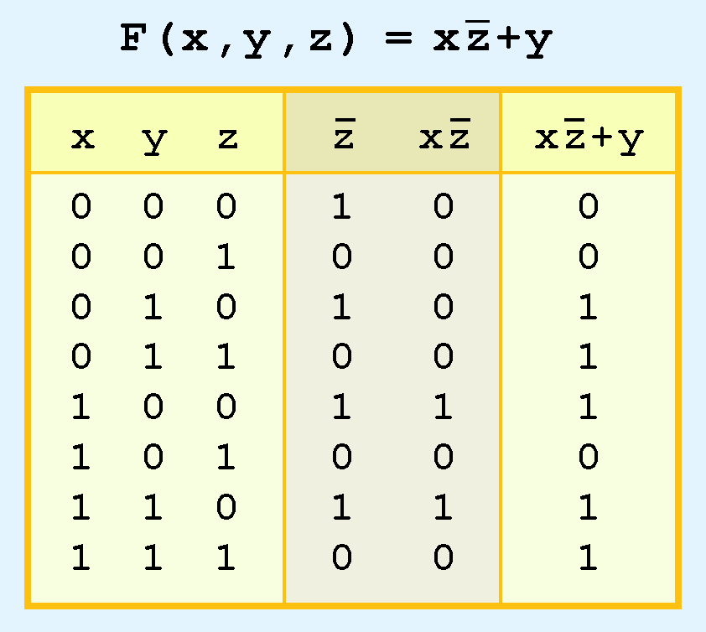
8.2 Truth Table
8. Circuit Design
8.1 Digital component
8.2 Truth table
8.3 Combinational Logic

Slide 35
8.3 Combinational Logic
We have designed a circuit that implements the Boolean function:
This circuit is an example of a combinational logic
circuit.
Combinational logic circuits produce a specified output (almost) at the instant when input values are applied.
In a later section, we will explore circuits where this is not the case.
8. Circuit Design
8.1 Digital component
8.2 Truth table
8.3 Combinational Logic

Slide 36
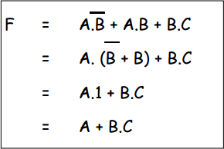
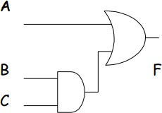
8.3.1 Combinational Circuit Examples
Example 1
8. Circuit Design
8.1 Digital component
8.2 Truth table
8.3 Combinational Logic
8.3.1 Examples
Circuit after Simplification

Slide 37
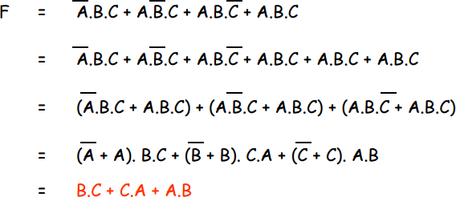
8.3.1 Combinational Circuit Examples
Example 2
8. Circuit Design
8.1 Digital component
8.2 Truth table
8.3 Combinational Logic
8.3.1 Examples

Slide 38
8.3.1 Combinational Circuit Examples
Example
Simplify:
X = (A.B.C) +(A.B'.C) +(A'.B.C)
8. Circuit Design
8.1 Digital component
8.2 Truth table
8.3 Combinational Logic
8.3.1 Examples

Slide 39
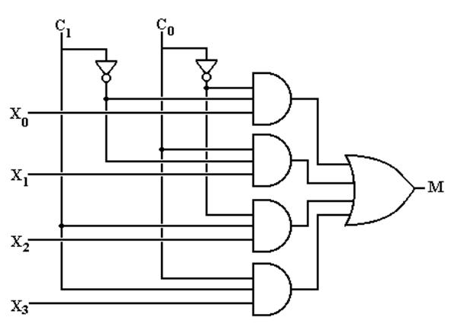
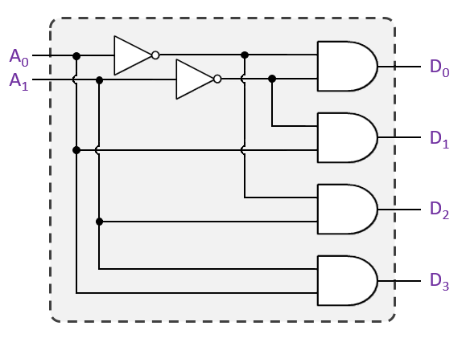
8.3.1 Combinational Circuit Examples
Example 4: Write the output functions of the following circuits.
8. Circuit Design
8.1 Digital component
8.2 Truth table
8.3 Combinational Logic
8.3.1 Examples
8.3.2 Exercises
Fig: Multiplexor
Fig: Decoder

Slide 40
Exercises
Simplify and construct the logic circuit:
A’.B’ + (A.B)’
(A + B).(A + B) + A.(A + B’)
(A.B’.C’ + A’.B’.C+A.B.C+A’.B.C’)
8. Circuit Design
8.1 Digital component
8.2 Truth table
8.3 Combinational Logic
8.3.1 Examples
8.3.2 Exercises
9. Summary

Slide 41
9. Summary
We have looked at the basic logic gates:
Identifying OR, AND, NOT, NAND, NOR and XOR.
We have seen that gates can be joined together to form Combinatorial Logic.
8. Circuit Design
8.1 Digital component
8.2 Truth table
8.3 Combinational Logic
8.3.1 Examples
8.3.2 Exercises
9. Summary
41

Slide 42
Thank you…
42

